Slide 1
Presentation
on
House Management System
Sadman Shafin
ID: 20183001010
Fuad Kabir
Id:20183013010

Slide 2
Introduction
In this project we have tried to design a software based on a Shop Management System. Here we separated every category of a shop by their price , quantity and code. Specially we used a feature called “Bkash payment system” which is the most using payment system of todays time in Bangladesh.
And, most importantly we used a “Gaming System” which will count the customers point and gain their discount on every buying.

Slide 3
Existing features
“Shop Management System” has been designed to computerize the following functions that are performed by the system :
Category
Computer & Electronics.
Fashion.
Men
Women
Grocery.
House.
Gaming.

Slide 4
Software requirements
System development software
Operating system: Windows 7 and above
Development platform: NetBeans
Language: JAVA
Server: Apache
Browser: Any

Slide 5
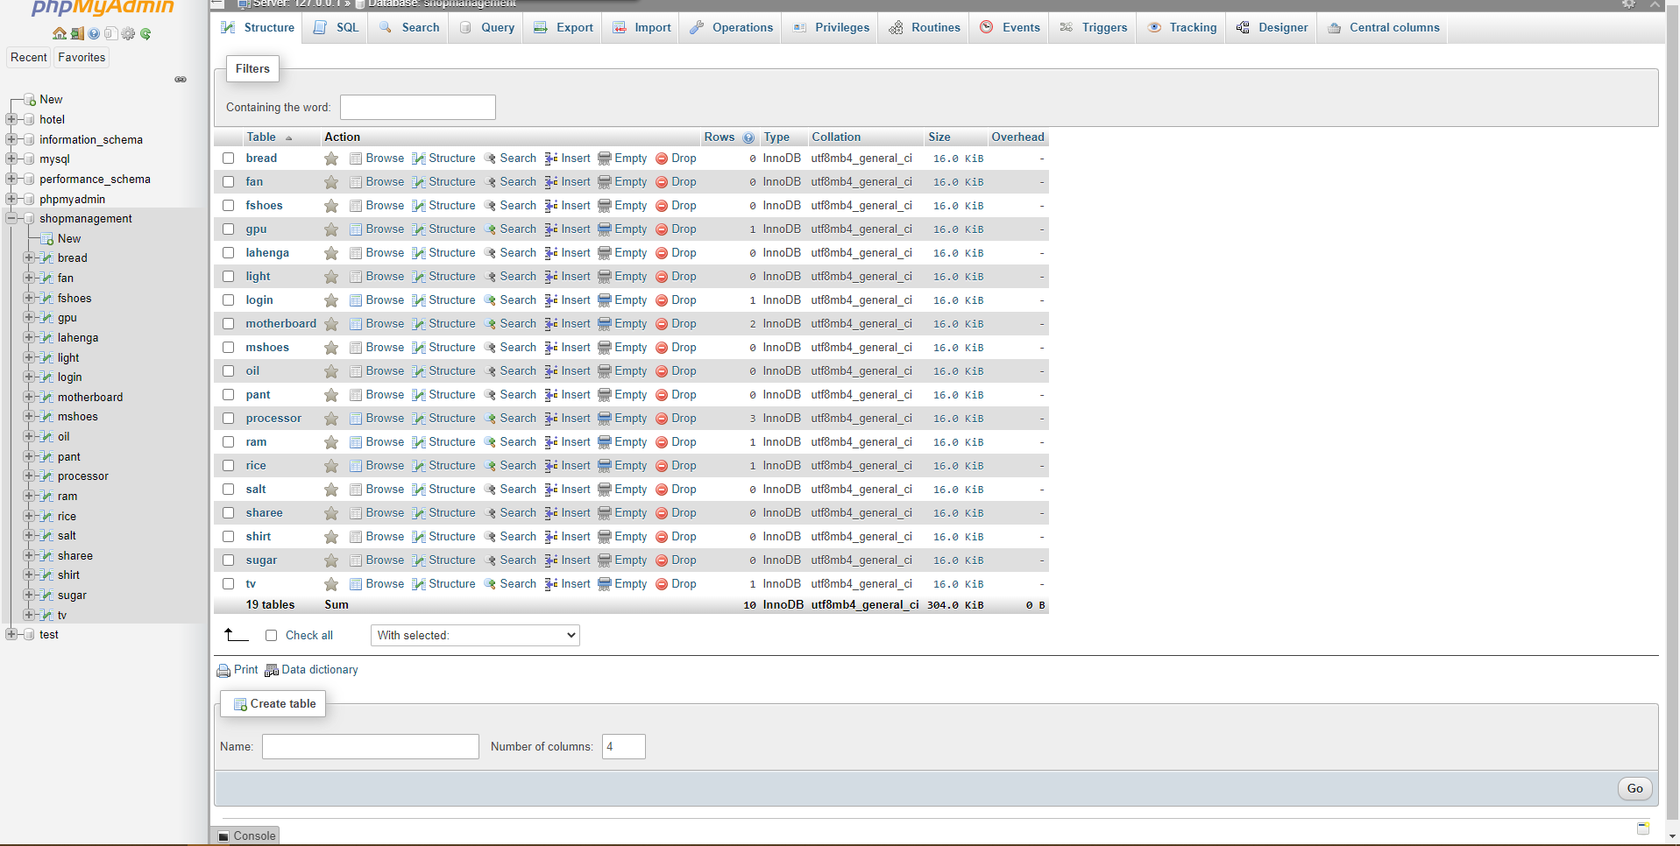
Database of Shop Management:

Slide 6
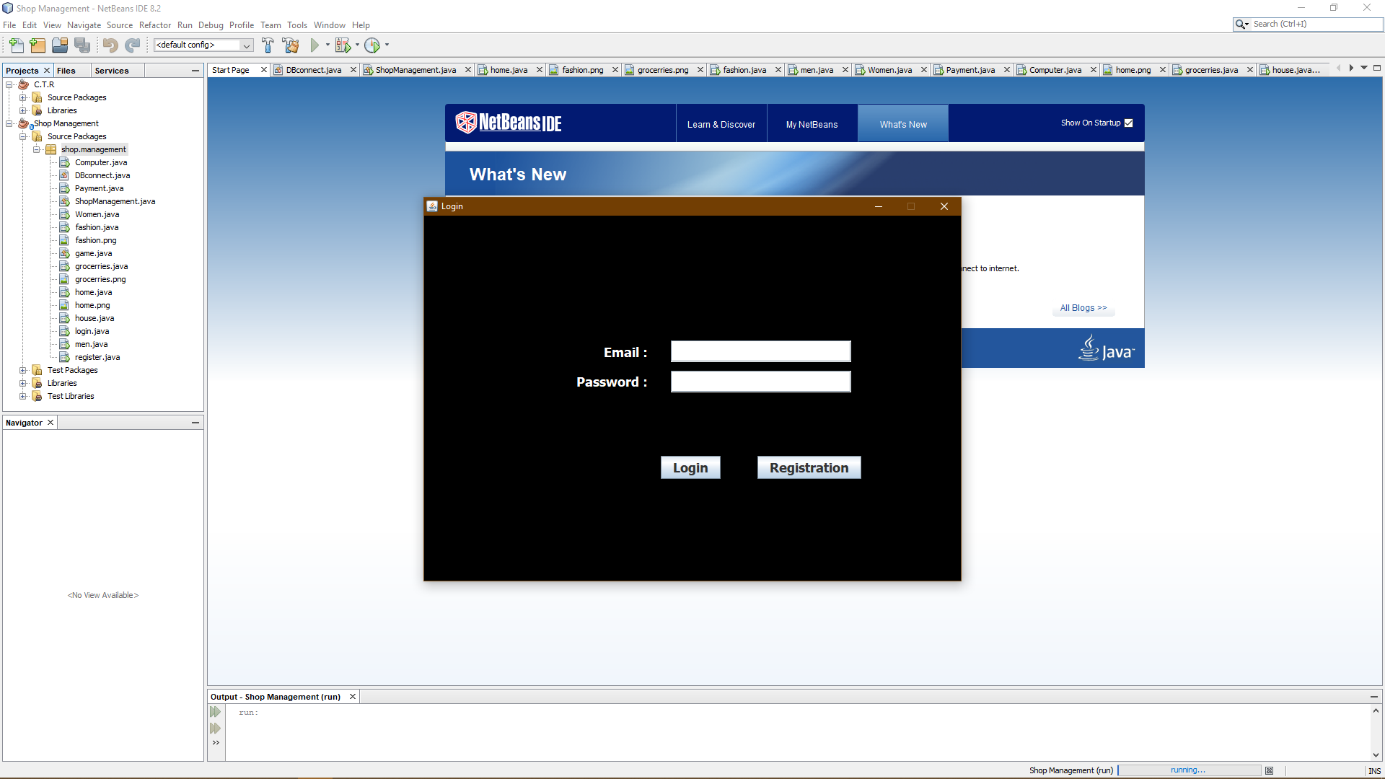
Login Page: In this page, we will register our account or if we are registered then we will log in to buy stuff.

Slide 7
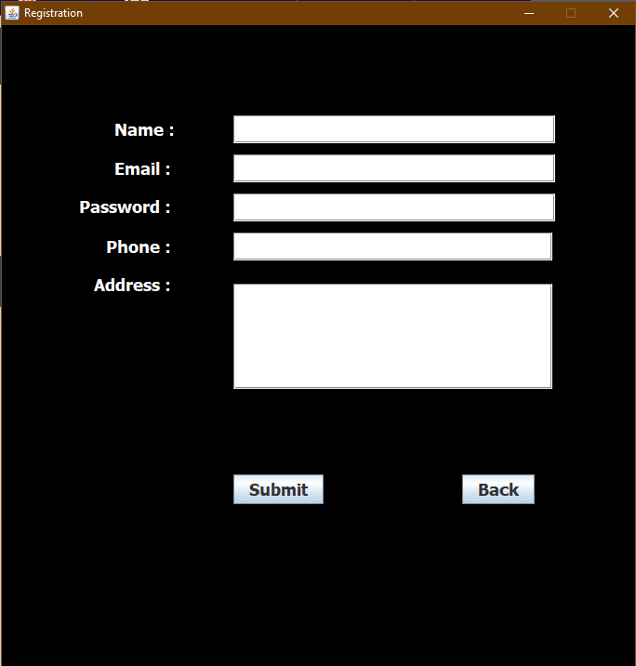
Registration page: In this page , we can register our new account to login.

Slide 8
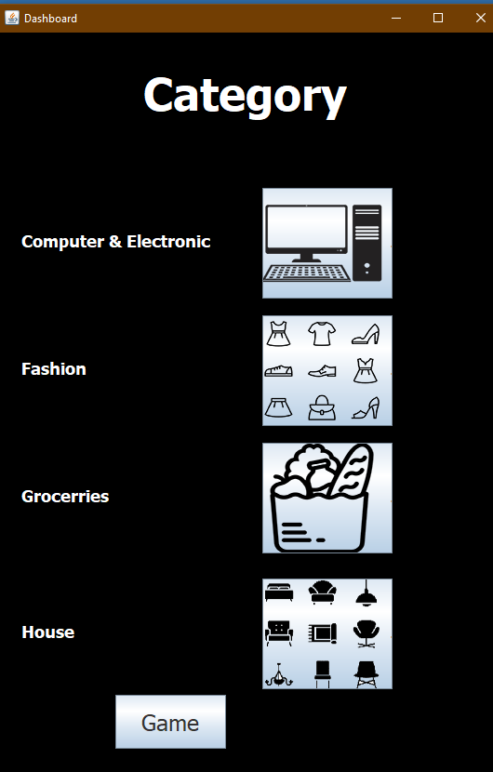
Category: After login we will see this page where we will fill about our stuffs that customers wants to buy.

Slide 9
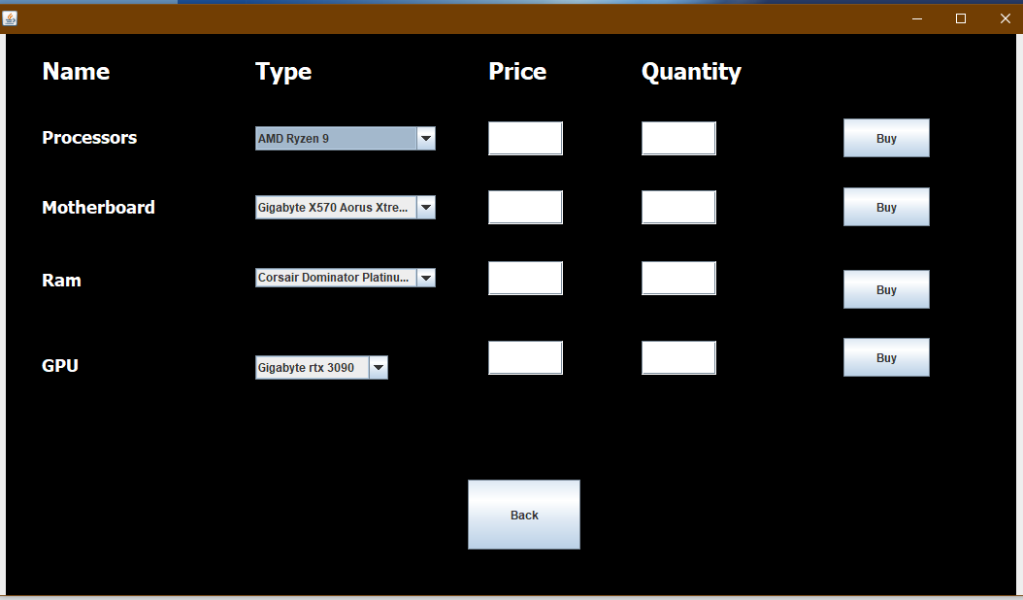
Computer & Electronics: This is the computer & electronics side:

Slide 10
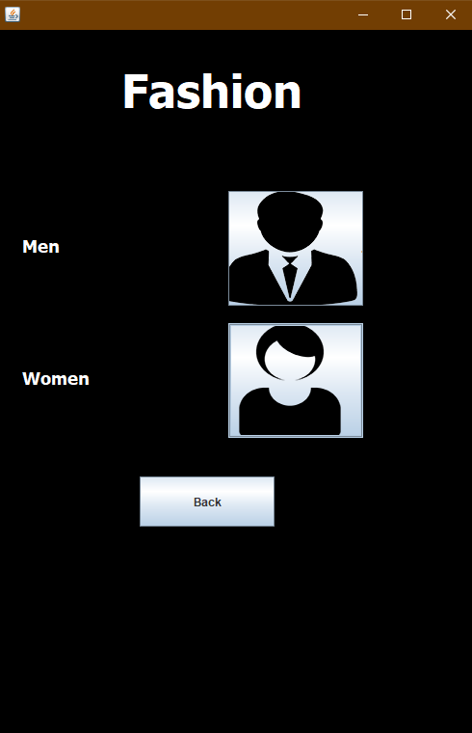
Fashion: In this page, we will find two option . One is about Men’s items. And the other one is about Women’s items.

Slide 11
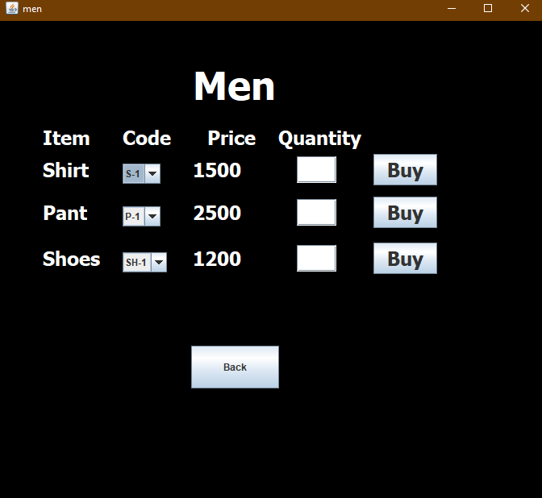
Men: Here we added 3 Men’s items.
In future we can add more if we want to.

Slide 12
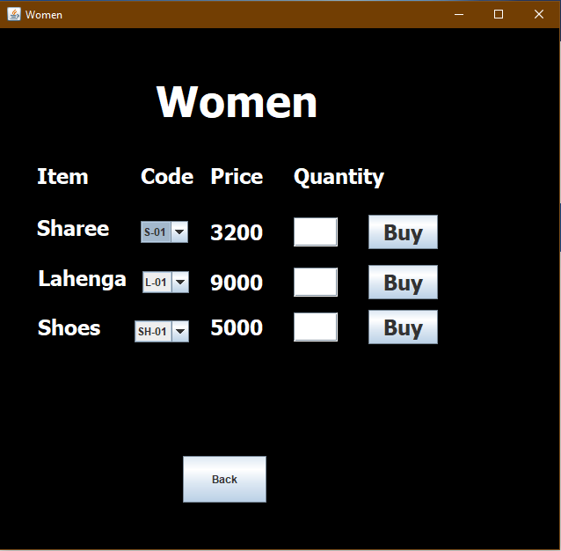
Women: Here we added 3 Women’s items.
In future we can add more if we want to.

Slide 13
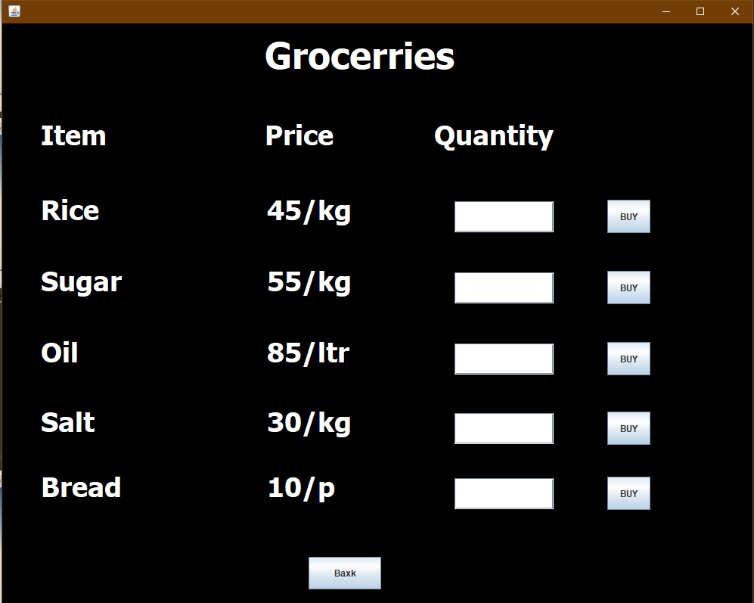
Groceries:

Slide 14
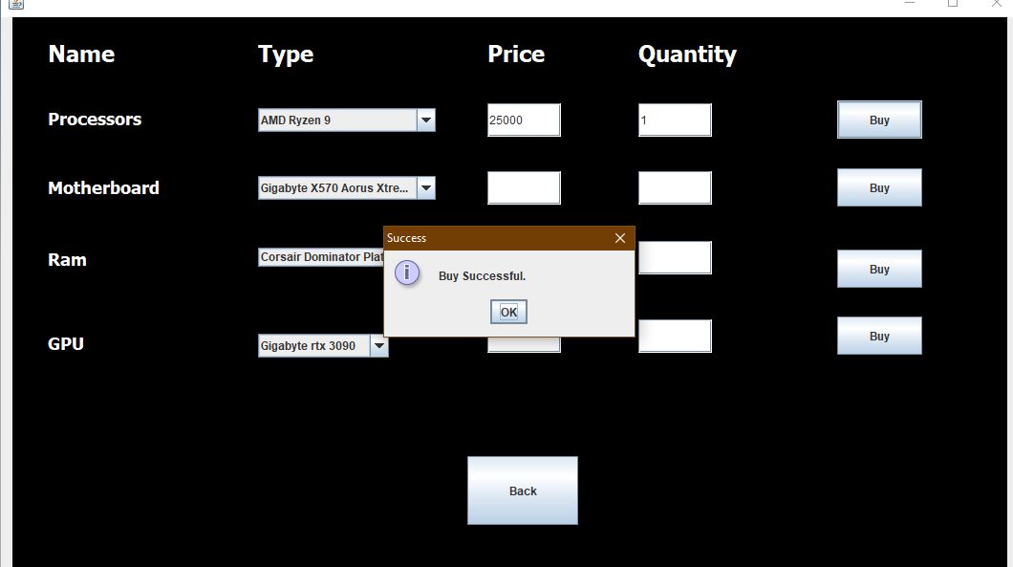
After buying: If our buying successful.

Slide 15
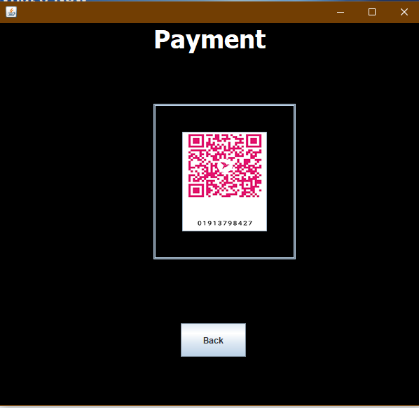
Bkash Payment system:
To complete the payment system we have to go through this system.
We have to scan this and complete the buying.

Slide 16
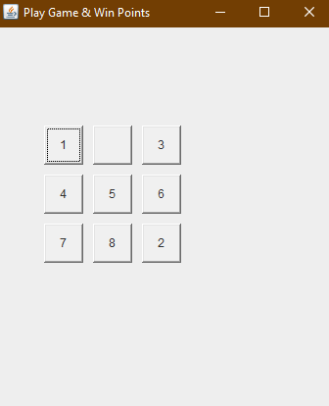
Gaming: This is the exciting part of our project. Where customers can solve the puzzle and get their point to get discount on their buying.

Slide 17
Future work
Change Design,
Online Visitors,
Payment Printout,
And many other thing.

Slide 18
Thank You

